Slide 1

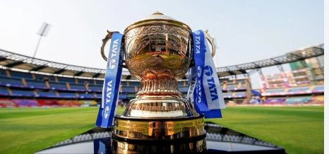

SQL FINAL PROJECT
IPL

Slide 2


HARYANA WARRIORS

Slide 3

Bidding on batters

Slide 4
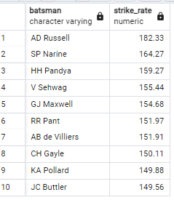



Your first priority is to get 2-3 players with high S.R who have faced at least 500 balls.And to do that you have to make a list of 10 players you want to bid in the auction so that when you try to grab them in auction you should not pay the amount greater than you have in the purse for a particular player

Slide 6
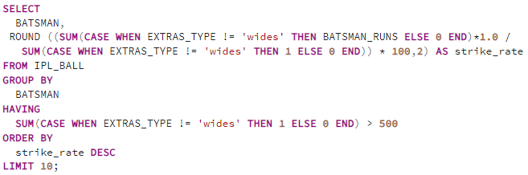
SELECT
BATSMAN,
ROUND ((SUM(CASE WHEN EXTRAS_TYPE != 'wides' THEN BATSMAN_RUNS ELSE 0 END)*1.0/
SUM(CASE WHEN EXTRAS_TYPE != 'wides' THEN 1 ELSE 0 END)) * 100,2) AS strike_rate
FROM IPL_BALL
GROUP BY
BATSMAN
HAVING
SUM(CASE WHEN EXTRAS_TYPE != 'wides' THEN 1 ELSE 0 END) > 500
ORDER BY
strike_rate DESC
LIMIT 10;

Slide 7
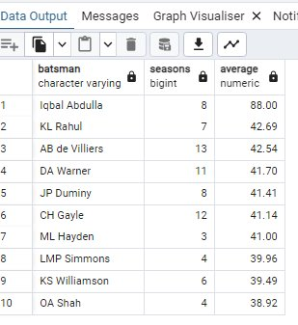
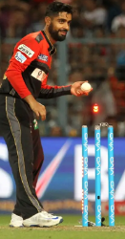
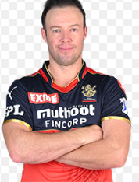

Now you need to get 2-3 players with good Average who have played more than 2 ipl seasons. And to do that you have to make a list of 10 players you want to bid in the auction so that when you try to grab them in auction you should not pay the amount greater than you have in the purse for a particular player.

Slide 9
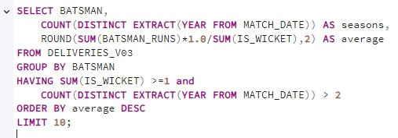
SELECT BATSMAN,
COUNT(DISTINCT EXTRACT(YEAR FROM MATCH_DATE)) AS seasons,
ROUND(SUM(BATSMAN_RUNS)*1.0/SUM(IS_WICKET),2) AS average
FROM DELIVERIES_V03
GROUP BY BATSMAN
HAVING SUM(IS_WICKET) >=1 and
COUNT(DISTINCT EXTRACT(YEAR FROM MATCH_DATE)) > 2
ORDER BY average DESC
LIMIT 10;

Slide 10
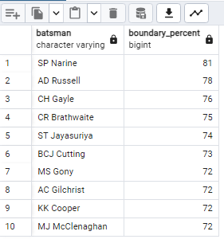

Now you need to get 2-3 Hard-hitting players who have scored most runs in boundaries and have played more the 2 ipl season. To do that you have to make a list of 10 players you want to bid in the auction so that when you try to grab them in auction you should not pay the amount greater than you have in the purse for a particular player.

Slide 12
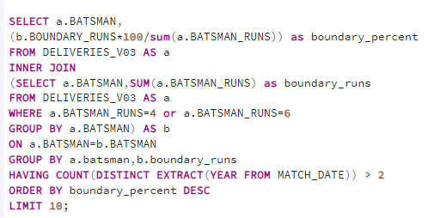
SELECT a.BATSMAN,
(b.BOUNDARY_RUNS*100/sum(a.BATSMAN_RUNS)) as boundary_percent
FROM DELIVERIES_V03 AS a
INNER JOIN
(SELECT a.BATSMAN,SUM(a.BATSMAN_RUNS) as boundary_runs from DELIVERIES_V03 AS a
WHERE a.BATSMAN_RUNS=4 or a.BATSMAN_RUNS=6
GROUP BY a.BATSMAN) AS b
ON a.BATSMAN=b.BATSMAN
GROUP BY a.batsman,b.boundary_runs
HAVING COUNT(DISTINCT EXTRACT(YEAR FROM MATCH_DATE)) > 2
ORDER BY boundary_percent DESC
LIMIT 10;

Slide 13

BIDDING ON BOWLERS

Slide 14
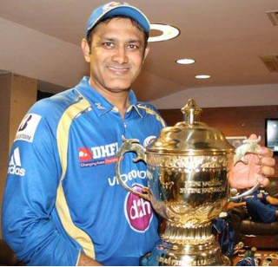
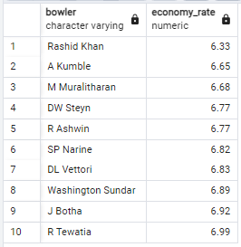
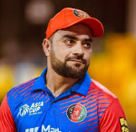
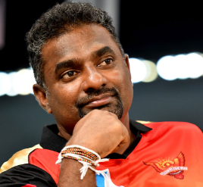
Your first priority is to get 2-3 bowlers with good economy who have bowled at least 500 balls in IPL so far.To do that you have to make a list of 10 players you want to bid in the auction so that when you try to grab them in auction you should not pay the amount greater than you have in the purse for a particular player.

Slide 16
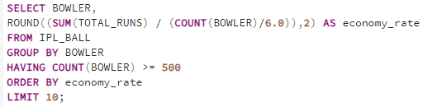
SELECT BOWLER,
ROUND((SUM(TOTAL_RUNS) / (COUNT(BOWLER)/6.0)),2) AS economy_rate
FROM IPL_BALL
GROUP BY BOWLER
HAVING COUNT(BOWLER) >= 500
ORDER BY economy_rate
LIMIT 10;

Slide 17
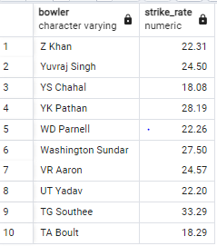
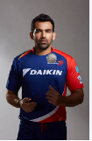


Now you need to get 2-3 bowlers with the best strike rate and who have bowled at least 500 balls in IPL so far.To do that you have to make a list of 10 players you want to bid in the auction so that when you try to grab them in auction you should not pay the amount greater than you have in the purse for a particular player.

Slide 19
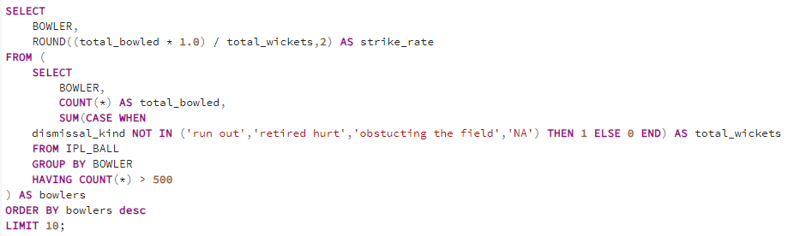
SELECT
BOWLER,
ROUND((total_bowled * 1.0) / total_wickets,2) AS strike_rate
FROM (
SELECT
BOWLER,
COUNT(*) AS total_bowled,
SUM(CASE WHEN
dismissal_kind NOT IN ('run out','retired hurt','obstucting the field','NA') THEN 1 ELSE 0 END) AS total_wickets
FROM IPL_BALL
GROUP BY BOWLER
HAVING COUNT(*) >= 500
) AS bowlers
ORDER BY bowlers desc
LIMIT 10;

Slide 20

BIDDING ON ALL - ROUNDERS

Slide 21
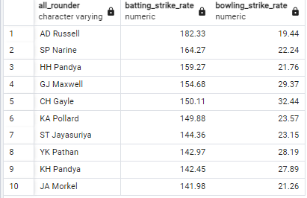
Now you need to get 2-3 All_rounders with the best batting as well as bowling strike rate and who have faced at least 500 balls in IPL so far and have bowled minimum 300 balls.To do that you have to make a list of 10 players you want to bid in the auction so that when you try to grab them in auction you should not pay the amount greater than you have in the purse for a particular player.

Slide 23
CREATE TABLE BATTING_STRIKE_RATE AS SELECT
BATSMAN,
ROUND ((SUM(CASE WHEN EXTRAS_TYPE != 'wides' THEN BATSMAN_RUNS ELSE 0 END)*1.0 /
SUM(CASE WHEN EXTRAS_TYPE != 'wides' THEN 1 ELSE 0 END)) * 100,2) AS batting_strike_rate
FROM IPL_BALL
GROUP BY
BATSMAN
HAVING
SUM(CASE WHEN EXTRAS_TYPE != 'wides' THEN 1 ELSE 0 END) > 500
ORDER BY
batting_strike_rate DESC;
BATTING_STRIKE_RATE
BOWLING_STRIKE_RATE
CREATE TABLE BOWLING_STRIKE_RATE AS SELECT
BOWLER,
ROUND((total_bowled * 1.0) / total_wickets,2) AS bowler_strike_rate
FROM (
SELECT
BOWLER,
COUNT(*) AS total_bowled,
SUM(CASE WHEN
dismissal_kind NOT IN ('run out','retired hurt','obstucting the field','NA') THEN 1 ELSE 0 END) AS total_wickets
FROM IPL_BALL
GROUP BY BOWLER
HAVING COUNT(*) >= 300
) AS bowlers
ORDER BY bowler_strike_rate;

Slide 24
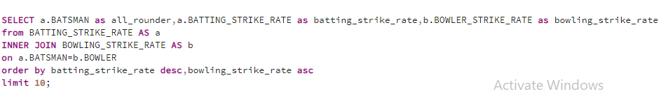
SELECT a.BATSMAN as all_rounder,a.BATTING_STRIKE_RATE as batting_strike_rate,b.BOWLER_STRIKE_RATE as bowling_strike_rate
from BATTING_STRIKE_RATE AS a
INNER JOIN BOWLING_STRIKE_RATE AS b
on a.BATSMAN=b.BOWLER
order by batting_strike_rate desc,bowling_strike_rate asc
limit 10;

Slide 25

BIDDING ON WICKETKEEPER

Slide 26
To get two best wicketkeepers for an IPL team, to choose the ideal wicketkeeper we will have to evaluate them based on following criteria :
1. Batting Ability
Strike Rate and Aggression: We require quick scoring and aggressive batting to build partnerships and finish innings effectively.
Run getter :The wicketkeeper should be capable of playing crucial innings under pressure
2. Wicketkeeping Skills
Catching Ability: Reliable catching, especially on tough deliveries and edges, is essential.
b. Stumping Skills: Stumpings are often require quick reflexes and awareness.
3. Strategic Awareness during field setting
Game Awareness: A wicketkeeper’s ability to read the game and support is valuable for captain in the field.
Communication Skills: Clear and strategic communication helps in setting up the field and executing plans.
Final Selection
Based on the criteria above, evaluate the candidates to choose the two wicketkeepers who excel in aggressive batting, effective keeping, versatile fielding, strategic thinking, recent form, and fitness.

Slide 27
ADDITIONAL QUESTIONS

Slide 28
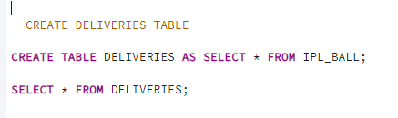
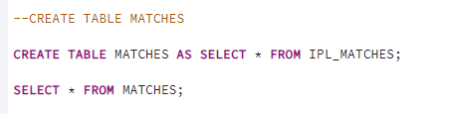
CREATING DELIVERIES AND MATCHES TABLE
CREATE TABLE DELIVERIES AS SELECT * FROM IPL_BALL;
CREATE TABLE MATCHES AS SELECT * FROM IPL_MATCHES;

Slide 29

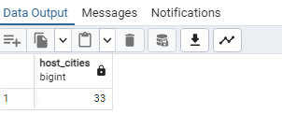
1. Get the count of cities that have hosted an IPL match
SELECT COUNT(DISTINCT CITY) AS HOST_CITIES
FROM MATCHES;

Slide 30
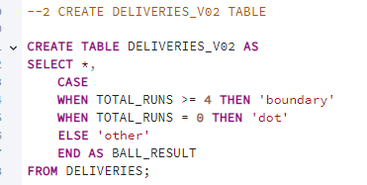
2. Create table deliveries_v02 with all the columns of the table ‘deliveries’ and an additional column ball_result containing values boundary, dot or other depending on the total_run
CREATE TABLE DELIVERIES_V02 AS
SELECT *,
CASE
WHEN TOTAL_RUNS >= 4 THEN 'boundary'
WHEN TOTAL_RUNS = 0 THEN 'dot'
ELSE 'other'
END AS BALL_RESULT
FROM DELIVERIES;

Slide 31
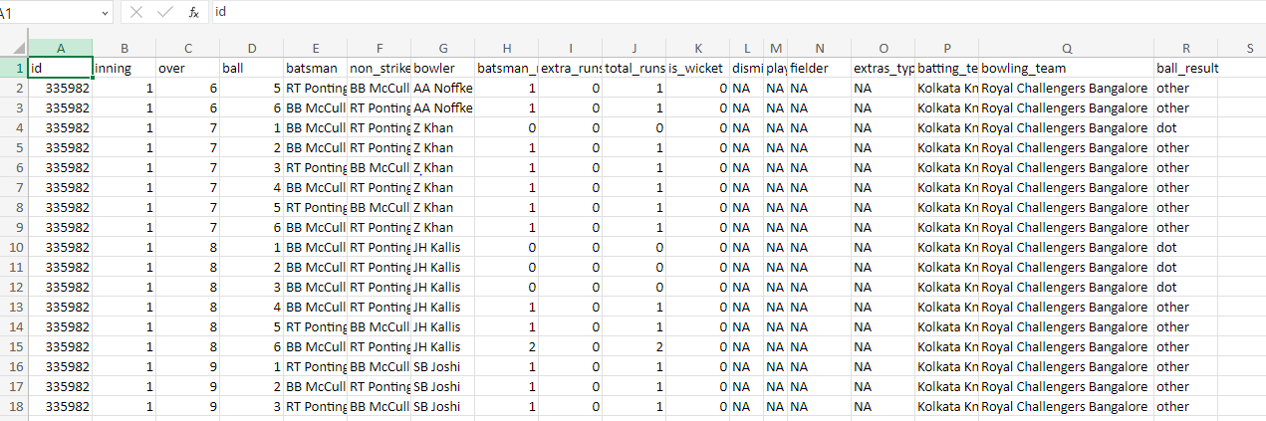

Slide 32

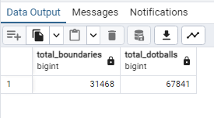
3 Write a query to fetch the total number of boundaries and dot balls from the deliveries_v02 table.
SELECT
SUM(CASE WHEN BALL_RESULT = 'boundary' THEN 1 ELSE 0 END) AS total_boundaries,
SUM(CASE WHEN BALL_RESULT = 'dot' THEN 1 ELSE 0 END) AS total_dotballs
FROM DELIVERIES_V02 ;

Slide 33
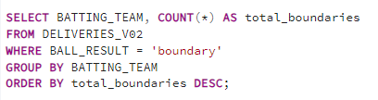
4 Write a query to fetch the total number of boundaries scored by each team from the deliveries_v02 table and order it in descending order of the number of boundaries scored.
SELECT BATTING_TEAM, COUNT(*) AS total_boundaries
FROM DELIVERIES_V02
WHERE BALL_RESULT = 'boundary'
GROUP BY BATTING_TEAM
ORDER BY total_boundaries DESC;

Slide 34
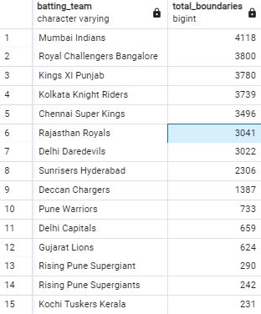

Slide 35
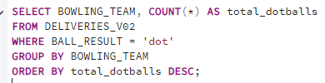
5 Write a query to fetch the total number of dot balls bowled by each team and order it in descending order of the total number of dot balls bowled.
SELECT BOWLING_TEAM, COUNT(*) AS total_dotballs
FROM DELIVERIES_V02
WHERE BALL_RESULT = 'dot'
GROUP BY BOWLING_TEAM
ORDER BY total_dotballs DESC;

Slide 36
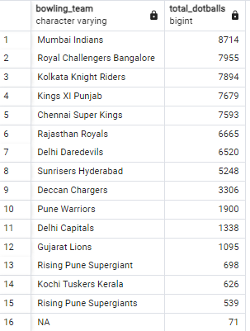

Slide 37

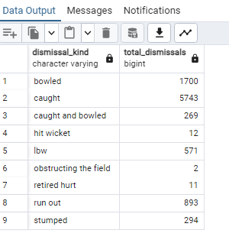
6 Write a query to fetch the total number of dismissals by dismissal kinds where dismissal kind is not NA
SELECT DISMISSAL_KIND, COUNT(*) AS total_dismissals
FROM DELIVERIES_V02
WHERE DISMISSAL_KIND != 'NA'
GROUP BY DISMISSAL_KIND;

Slide 38
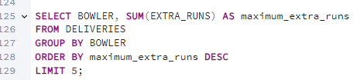
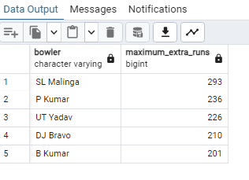
7 Write a query to get the top 5 bowlers who conceded maximum extra runs from the deliveries table
SELECT BOWLER, SUM(EXTRA_RUNS) AS maximum_extra_runs
FROM DELIVERIES
GROUP BY BOWLER
ORDER BY maximum_extra_runs DESC
LIMIT 5;

Slide 39
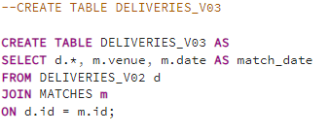
8. Write a query to create a table named deliveries_v03 with all the columns of deliveries_v02 table and two additional column (named venue and match_date) of venue and date from table matche
CREATE TABLE DELIVERIES_V03 AS
SELECT d.*, m.venue, m.date AS match_date
FROM DELIVERIES_V02 d
JOIN MATCHES m
ON d.id = m.id;

Slide 40
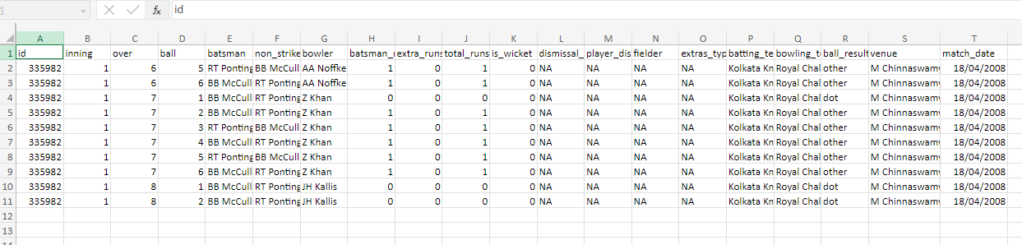

Slide 41
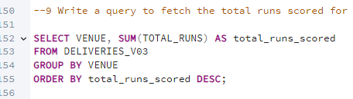
9 Write a query to fetch the total runs scored for each venue and order it in the descending order of total runs scored
SELECT VENUE, SUM(TOTAL_RUNS) AS total_runs_scored
FROM DELIVERIES_V03
GROUP BY VENUE
ORDER BY total_runs_scored DESC;

Slide 42
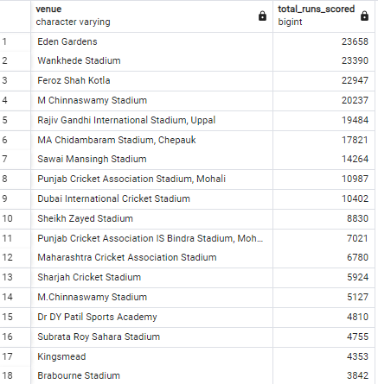
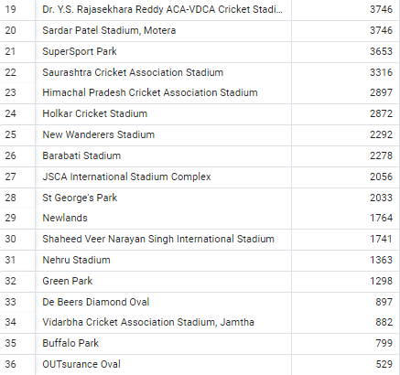

Slide 43

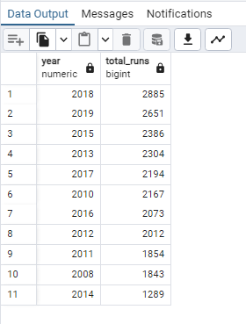
10 Write a query to fetch the year-wise total runs scored at Eden Gardens and order it in the descending order of total runs scored.
SELECT EXTRACT(YEAR FROM MATCH_DATE) AS year, SUM(TOTAL_RUNS) AS total_runs
FROM DELIVERIES_V03
WHERE VENUE = 'Eden Gardens'
GROUP BY EXTRACT(YEAR FROM MATCH_DATE)
ORDER BY total_runs DESC;

Slide 44
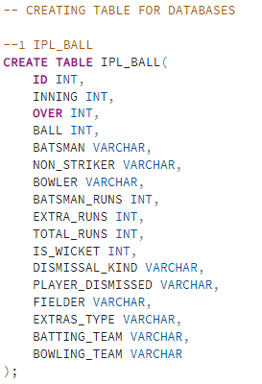
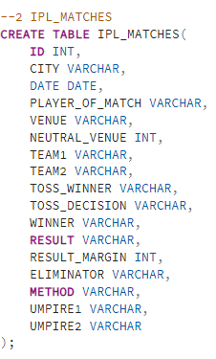
CREATING TABLE FOR DATABASES

Slide 45
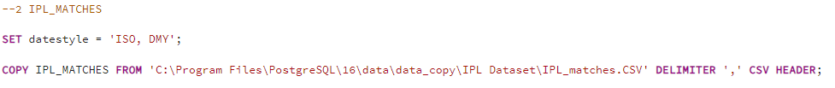
IMPORTING DATA FROM FILE

Slide 46
THE END
CREATED BY : SHIVAM GANDHI

